Slide 1
HR METRICS AND ANALYTICS FOR
XTREME FURNITURE & CO

Slide 2
Introduction
Xtreme Furniture & Co, a well-established name in the furniture industry, has been synonymous with quality and innovation. The company has built a reputation for delivering top-notch furniture solutions that seamlessly blend aesthetics and functionality.

Slide 3
Culture Metrics
Xtreme Furniture & Co should focus on shaping its organizational culture by instilling core beliefs, practices, and values that promote a sense of belonging among employees and create a comfortable workplace environment.
It is crucial to ensure that employees understand the company's culture elements, including values and ideologies.
Cultural change should be a gradual and carefully planned process.

Slide 4
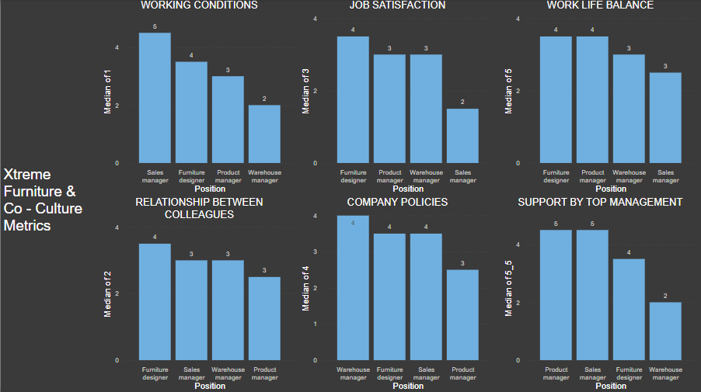
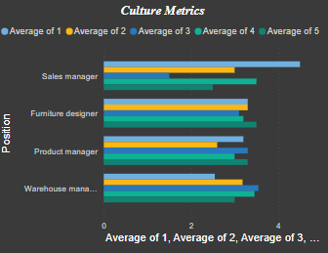
DASHBOARD
there are variations in performance metrics across all four positions, indicating differences in job responsibilities and performance levels within the organization.
the analysis reveals a wide performance gap between the Sales Manager and the Warehouse Manager, with the Sales Manager achieving significantly higher

Slide 5
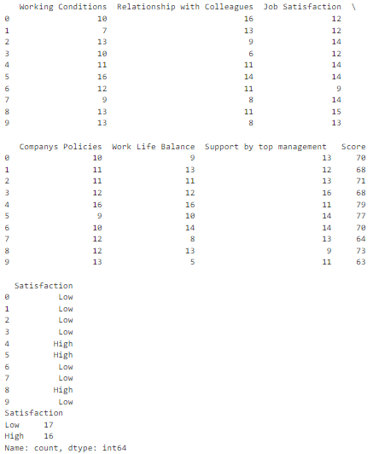
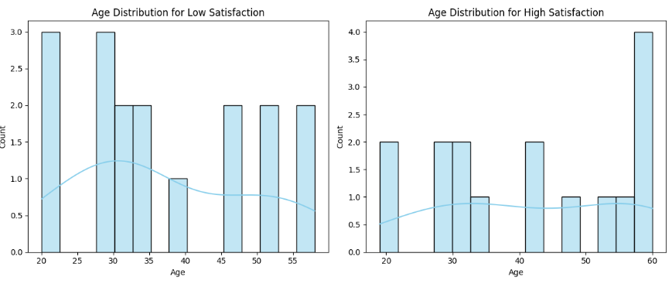
Employees with higher overall scores in these areas tend to report higher job satisfaction.
Further analysis and employee feedback may be needed to make more specific recommendations for improving job satisfaction.

Slide 6
Competency Metrics
Xtreme Furniture & Co should focus on fostering a culture of skill and knowledge development among employees.
This entails identifying and communicating core competencies, creating a competency framework, conducting regular assessments, and providing learning and growth opportunities.
Recognizing and rewarding employees for demonstrating these competencies, along with clear communication, transparency, and leadership examples, are key components.
Cultural change should be gradual and well-planned, ensuring that employees understand the importance of competencies in their careers and the organization's success.
Regular feedback and evaluation should guide the effectiveness of competency development initiatives.

Slide 7
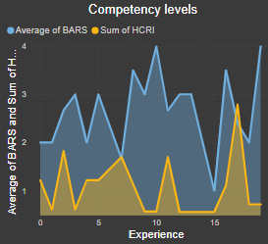
DASHBOARD
it points out a significant divergence between the "BARS" and the "HCRI" at an experience level of 10

Slide 8

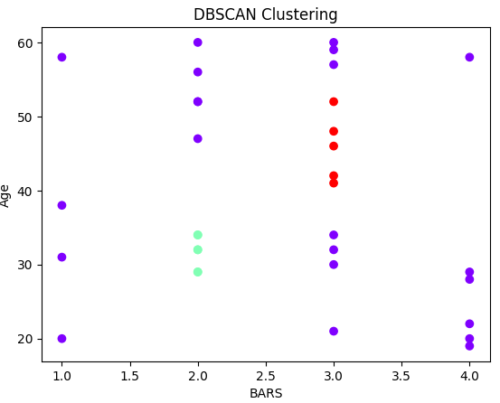
The correlation analysis reveals a weak positive correlation (0.041) between BARS (Behaviorally Anchored Rating Scale) and HCRI (Human Capital Return on Investment), suggesting a limited relationship between these two variables.

Slide 9
Cost & Productivity Metrics
Xtreme Furniture & Co should prioritize cost control, streamline processes, and invest training.
Clear, measurable performance metrics should be established, fostering a culture of continuous improvement and innovation.
Resource allocation should be optimized, and supply chain efficiencies improved through regular benchmarking.
Effective communication and collaboration among departments are essential to align goals and identify cost-saving opportunities.
Regular evaluation and adjustments based on data and feedback will ensure sustained progress in achieving cost-efficiency and productivity goals.

Slide 10
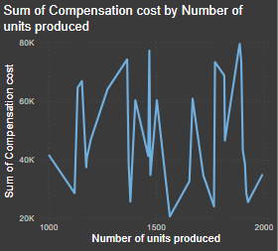
DASHBOARD
There is a substantial differences in compensation costs across various production levels.
A small number of units contributed significantly to the overall compensation costs, indicating potential areas for cost optimization or further investigation into factors driving these variations in labor expenses.

Slide 11
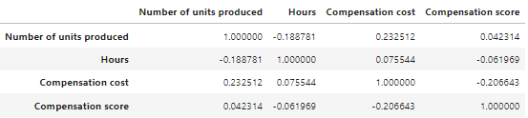
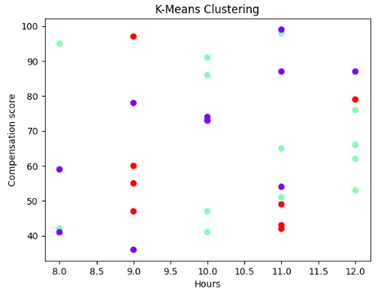
There's a slight negative correlation between the number of units produced and hours worked, suggesting that higher productivity may lead to fewer hours worked, possibly indicating improved efficiency.
A positive correlation exists between the number of units produced and compensation cost, indicating that increased production is associated with higher labor costs.
There's a weak negative correlation between hours worked and the compensation score, implying that longer working hours may slightly lower employee satisfaction with compensation.
A negative correlation exists between compensation cost and the compensation score, indicating that higher costs don't necessarily equate to higher employee satisfaction.

Slide 12
Recruitment Metrics
Xtreme Furniture & Co should prioritize assessing the skill sets and motivations of candidates during the recruitment process to reduce attrition within the organization.
This includes evaluating alignment with the role, understanding the learning curve, and considering career aspirations before hiring.
The company should refine its hiring methods and develop strategies to ensure the selection of the right candidates.

Slide 13
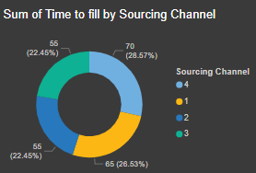
DASHBOARD
Sourcing channel 4 could be a valuable focus area to improve efficiency and reduce recruitment timelines.

Slide 14
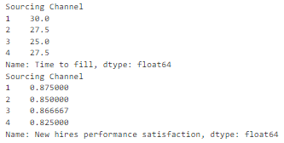
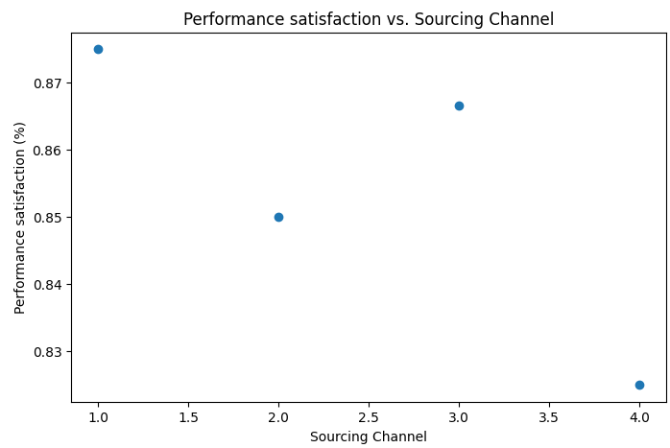
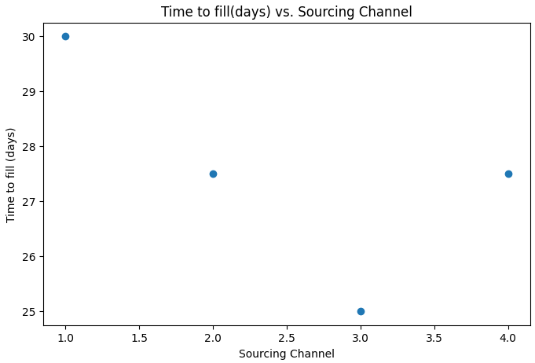
Sourcing Channels
Job Boards
Employee Referrals
Social network
Recruitment agencies
Sourcing Channels 1 and 4 seem to perform well in terms of both quick hiring and high new hire satisfaction
While Sourcing Channels 2 and 3 are somewhat in the middle, indicating room for improvement in either time to fill or satisfaction metrics.

Slide 15
Learning and development Metrics
Xtreme Furniture & Co should prioritize helping employees reach their personal and professional goals to create a strong talent pool.
The company should focus on understanding employees' Learning and Development plans to ensure their long tenure with the organization.
HR should collaborate with department managers to plan effective training and workshops based on performance and roles.
Learning and development programs should align with core competencies and skills essential to the furniture industry.

Slide 16
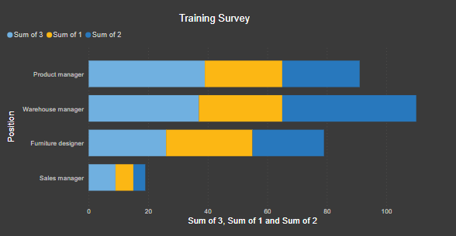
DASHBOARD
significant variations in the metric across different positions, with the warehouse manager having the highest score

Slide 17
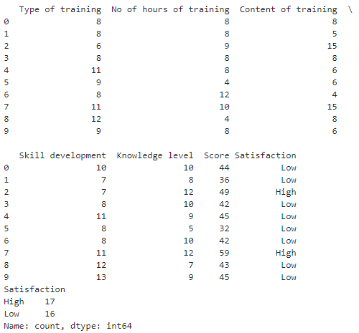
it's evident that the content of training varies, with some employees receiving longer and more extensive training.
However, despite differences in training duration and content, both high and low satisfaction scores are present, indicating that training alone may not be the sole driver of job satisfaction.

Slide 18
Performance Management Metrics
Xtreme Furniture & Co should establish strategic performance standards for each position, including personal performance goals aligned with company objectives.
This approach will help identify high-performing employees, align actions with organizational goals, enhance operational efficiency, and ensure equitable distribution of incentives.

Slide 19
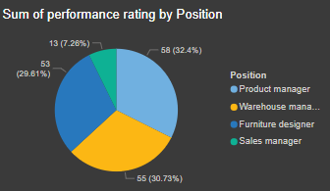
DASHBOARD
the analysis highlights the varying performance ratings among different positions within the organization. The Product Manager stands out with the highest rating, contributing significantly to the overall metric.

Slide 20
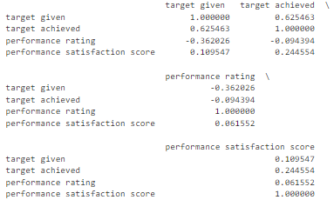
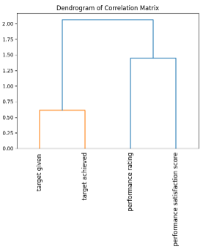
The analysis indicates that target achievement is positively related to performance satisfaction, but higher assigned targets may be associated with slightly lower performance ratings.

Slide 21
Talent Management Metrics
Xtreme Furniture & Co should prioritize the motivation and retention of talent.
This includes attracting talented individuals seeking long-term stability in the furniture industry.
Focusing on talent management will help identify key performers and roles, leading to improved processes in customer support, quality management, and product design, resulting in higher customer and client satisfaction, business growth, and financial efficiency.

Slide 22
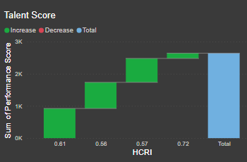
DASHBOARD
Talent score increases gradually while training the employees regularly to improve their performance.

Slide 23
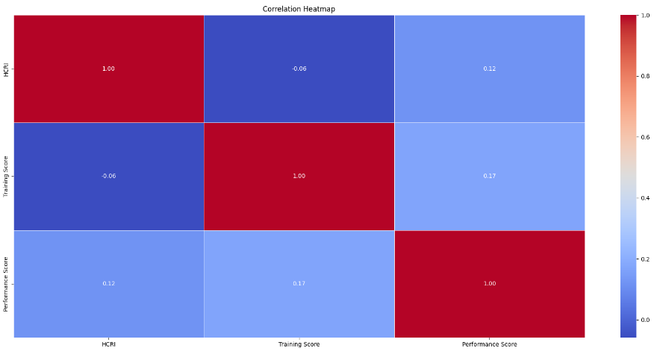
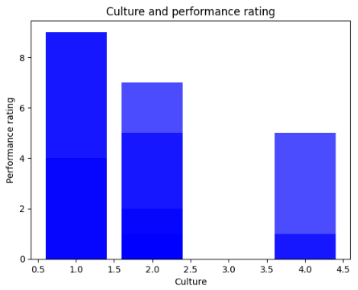
Correlations are relatively weak, and other factors beyond HCRI and training may significantly influence performance.

Slide 24
Thank You

